Slide 1

ECE 603 Probability and Random Processes
Lessons 1-3
Chapter 1
Basic Concepts
Notes:
Now: Slides with Annotation
Next: Slides with Annotation
*****Preparation Notes*****
Students taking this course should already have covered linear algebra elsewhere.
We will use linear algebra extensively in this course.

Slide 2
Objectives
Review set theory
Explore random experiments and probabilities
Examine conditional probability
Examine independence
Review law of total probability
Review Bayes’ rule
Explore conditional independence
Chapter 1
Notes:
Now: Slides with Annotation
Next: Slides with Annotation

Slide 3
Rationale
An exploration of the basic concepts of probability will provide a foundation for discussion.
Mathematical concepts are necessary for understanding probability theory.
This lesson focuses on random experiments and the axioms of probability.
You will explore discrete and continuous probability models, before discussing conditional probability.
Chapter 1
Notes:
Now: Slides with Annotation
Next: Slides with Annotation

Slide 4
Prior Learning
A level of mathematical maturity consistent with the graduate engineering level.
Access to the online textbook: https://www.probabilitycourse.com/
Chapter 1
Notes:
Now: Slides with Annotation
Next: Slides with Annotation

Slide 5




Review of Set Theory
A set is an unordered collection of things (elements).
Chapter 1
Notes:
Now: Slides with Annotation
Next: Slides with Annotation

Slide 6


Review of Set Theory
The set of natural numbers,
The set of integers,
The set of real number
Chapter 1
Notes:
Now: Slides with Annotation
Next: Slides with Annotation

Slide 7






Review of Set Theory
Conditional probability of
Set is a subset of set if every element of is also an element of
We write where " " indicates "subset ".
Example:
Chapter 1
Notes:
Now: Slides with Annotation
Next: Slides with Annotation

Slide 8









Review of Set Theory
if and only if and
Example:
Universal set: The set of all things that we could possibly consider in a given context.
Universal set
Null set ;
For any set
Chapter 1
Notes:
Now: Slides with Annotation
Next: Slides with Annotation

Slide 9

Venn Diagrams
In a Venn diagram any set is depicted by a closed surface.
Chapter 1
Notes:
Now: Slides with Annotation
Next: Slides with Annotation

Slide 10



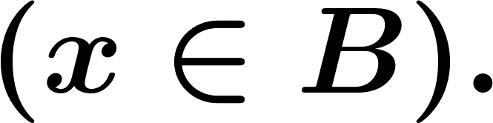

Set Operations
Union: The union of two sets and is denoted by and consist of all objects in or
if and only if or
Chapter 1
Notes:
Now: Slides with Annotation
Next: Slides with Annotation

Slide 11

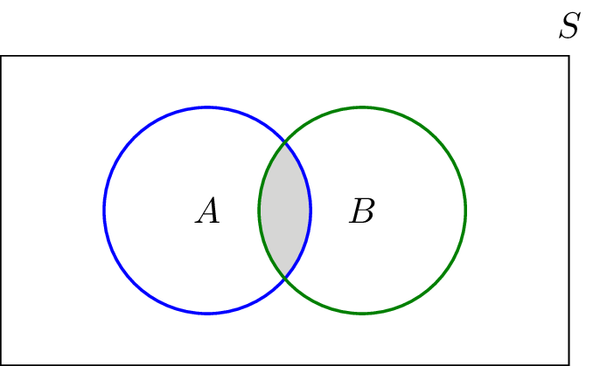
Set Operations
Intersection:
The intersection of two sets and is denoted by and consist of all objects in both and
Chapter 1
Notes:
Now: Slides with Annotation
Next: Slides with Annotation

Slide 12




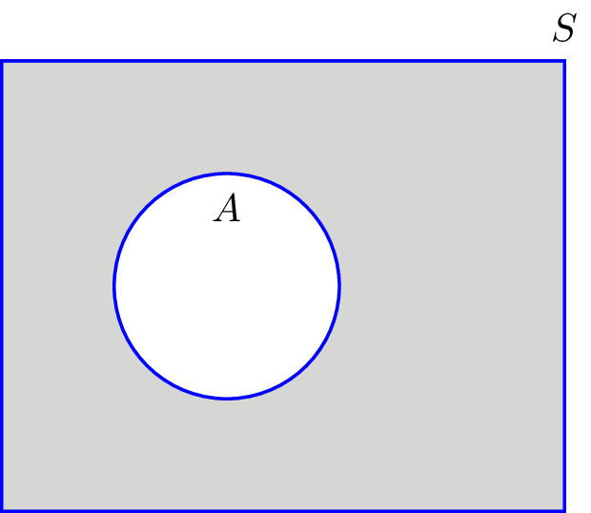


Set Operations
Complement:
The complement of a set denoted by is the set of all elements in that are Not in
Chapter 1
Notes:
Now: Slides with Annotation
Next: Slides with Annotation

Slide 13

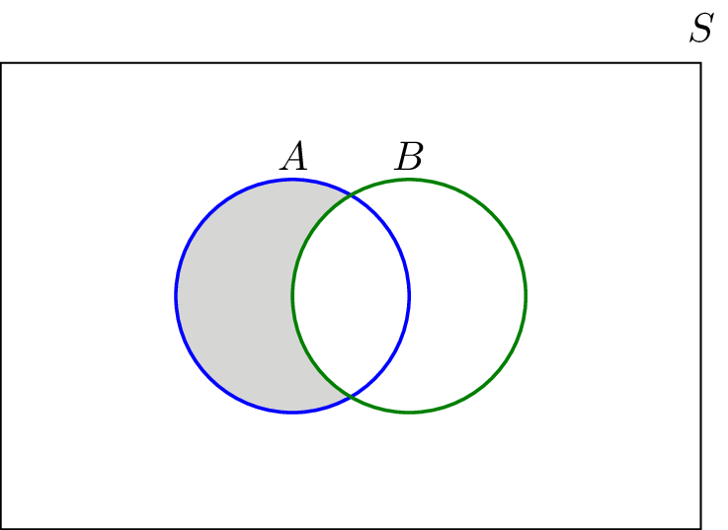

Set Operations
Difference (subtraction):
The subtraction of set from is all elements in that are not in
Chapter 1
Notes:
Now: Slides with Annotation
Next: Slides with Annotation

Slide 14






Set Operations
Mutually exclusive set (disjoint):
Two sets and are mutually exclusive (or disjoint) if
are m.e. if
Chapter 1
Notes:
Now: Slides with Annotation
Next: Slides with Annotation

Slide 15



Set Operations
Partition:
A collection of sets is a Partition of if
They are disjoint .
Chapter 1
Notes:
Now: Slides with Annotation
Next: Slides with Annotation

Slide 16
Set Operations
Theorem : De Morgan's law
Chapter 1
Notes:
Now: Slides with Annotation
Next: Slides with Annotation

Slide 17




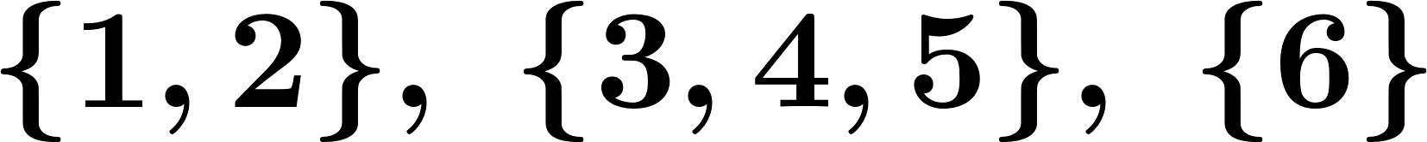

Set Operations
Example:
Let and
a) b) c)
d) f) g)
The sets form a partition of
Chapter 1
Notes:
Now: Slides with Annotation
Next: Slides with Annotation

Slide 18
Set Operations
Theorem : Distributive law
Chapter 1
Notes:
Now: Slides with Annotation
Next: Slides with Annotation

Slide 19
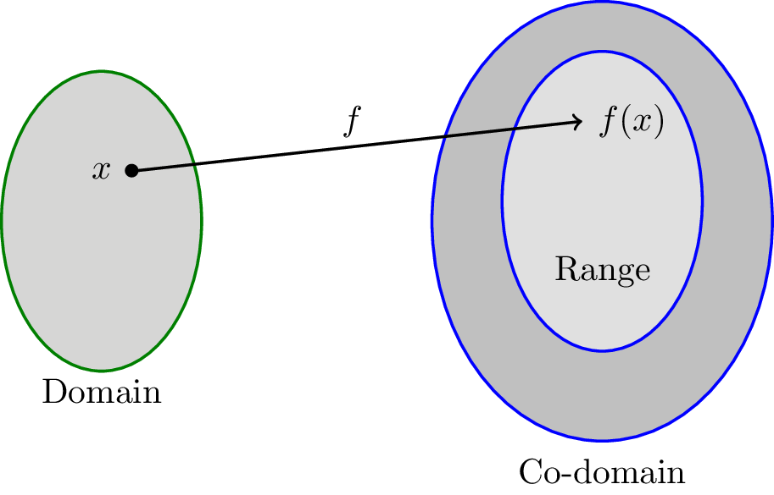






Functions
Domain
Co-domain
Range: the set of all the possible values of (Range )
Chapter 1
Notes:
Now: Slides with Annotation
Next: Slides with Annotation

Slide 20

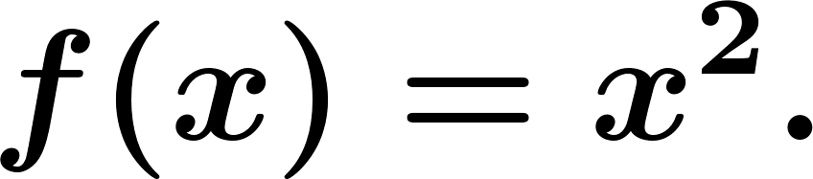

Functions
Example:
Consider the function defined as
one-to-one (invertible):
Chapter 1
Notes:
Now: Slides with Annotation
Next: Slides with Annotation

Slide 21


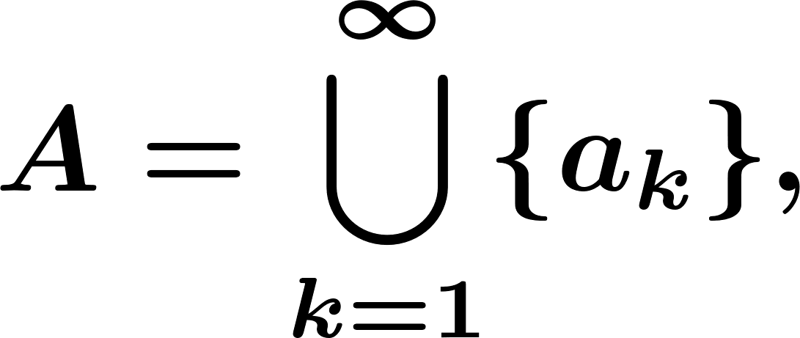


Countable and Uncountable Sets
Cardinality of a set is the number of elements in
set is finite if
set if countable if it is finite Or the elements of can be enumerated or listed in a sequence that is,
Ex: is countable.
Chapter 1
Notes:
Now: Slides with Annotation
Next: Slides with Annotation

Slide 22

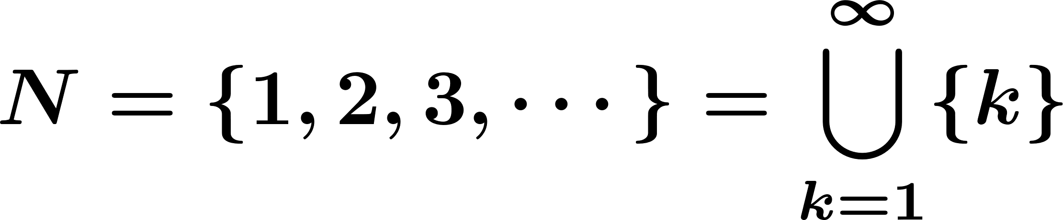
Countable and Uncountable Sets
Uncountable: Not countable.
e.g.,
Equivalently: set is countably infinite if it is in one-to-one correspondence with
Chapter 1
Notes:
Now: Slides with Annotation
Next: Slides with Annotation

Slide 23


Countable and Uncountable Sets
Example:
(set of integers) is countable (countably infinite).
Because
Chapter 1
Notes:
Now: Slides with Annotation
Next: Slides with Annotation

Slide 24
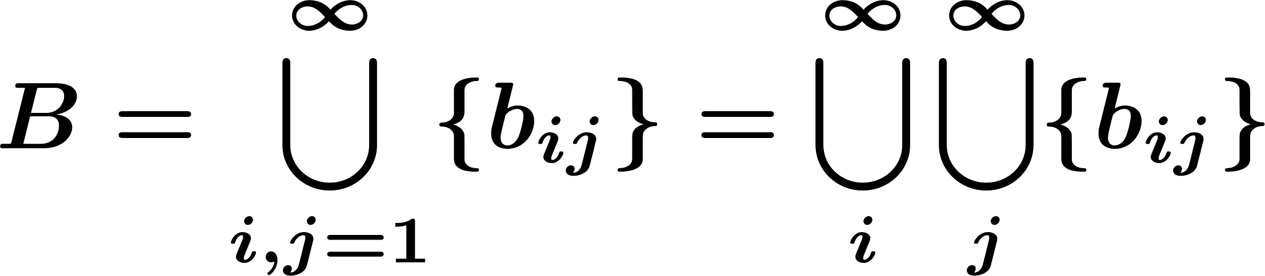
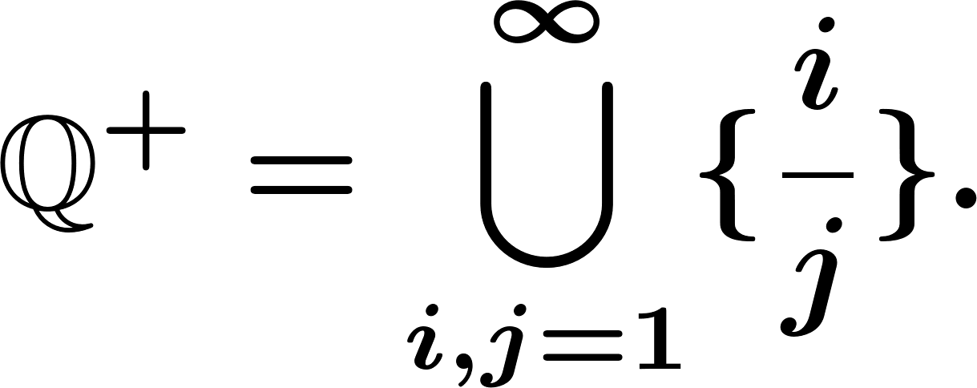
Countable and Uncountable Sets
Example:
Show that a set of the form is countable.
Example:
Show that the positive rational number form a countable set:
Chapter 1
Notes:
Now: Slides with Annotation
Next: Slides with Annotation

Slide 25
Countable and Uncountable Sets
Example:
Show that the positive rational number form a countable set:
Chapter 1
Notes:
Now: Slides with Annotation
Next: Slides with Annotation

Slide 26



Countable and Uncountable Sets
But is not countable.
In fact, any interval where is not countable.
Chapter 1
Notes:
Now: Slides with Annotation
Next: Orchestrated Conversation

Slide 27
Orchestrated Conversation: Review and Discussion
Review of Video and Exercises from Lesson 1 Video 1
Chapter 1
Notes:
Now: Orchestrated Conversation
Next: Slides with Annotation

Slide 28
Random experiment
Random experiment: A phenomenon whose outcome cannot be predicted with certainty, such as
Random experiment:
Roll a die
Roll a die three times
Flip a coin
Chapter 1
Notes:
Now: Slides with Annotation
Next: Slides with Annotation

Slide 29
Random experiment
Outcome:
An outcome is the result of a random experiment.
Roll a die 3
Roll a die 3 times (2, 3, 6)
Chapter 1
Notes:
Now: Slides with Annotation
Next: Slides with Annotation

Slide 30

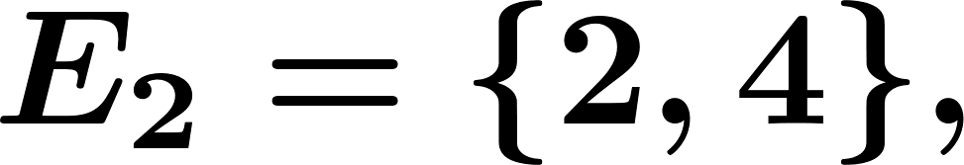
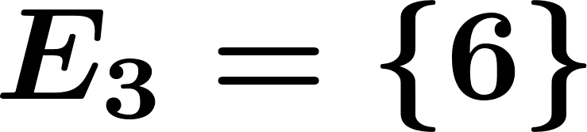
Random experiment
Events:
An event is collection of possible outcomes.
Roll a die (Event=E)
Chapter 1
Notes:
Now: Slides with Annotation
Next: Slides with Annotation

Slide 31

Random experiment
Sample Space:
The sample space is the set of all possible outcomes.
Roll a die: random experiment
Roll a die three times
an outcome
Chapter 1
Notes:
Now: Slides with Annotation
Next: Slides with Annotation

Slide 32
Random experiment
Event Set
Sample space Universal Set
Outcome Element
We say that an event occurs if the outcome of the experiment is an element of
Chapter 1
Notes:
Now: Slides with Annotation
Next: Slides with Annotation

Slide 33








Random experiment
Partition:
A partition is a collectively exhaustive, and mutually exclusive set of events, i.e.,
is a Partition if
Chapter 1
Notes:
Now: Slides with Annotation
Next: Slides with Annotation

Slide 34
Summary of Random experiment
Review of set theory
Random experiments: Roll a die, etc.
Outcome: An outcome is a result of random experiment.
Roll a die 3
Roll a die three times (3,6,2)
Chapter 1
Notes:
Now: Slides with Annotation
Next: Slides with Annotation

Slide 35



Summary of Random experiment
Sample Space: The set of all possible outcomes
Roll a die
Event: An event is a collection of possible outcomes.
An event is subset of
Roll a die :
Chapter 1
Notes:
Now: Slides with Annotation
Next: Slides with Annotation

Slide 36

Summary of Random experiment
We also say that an event has occurred if the outcome of the experiment is an element of
Roll a die 2 ,
Roll a die 3 times
elements.
Chapter 1
Notes:
Now: Slides with Annotation
Next: Slides with Annotation

Slide 37



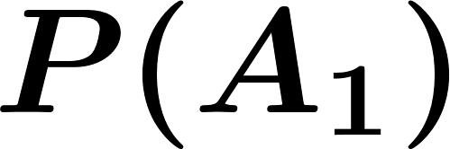
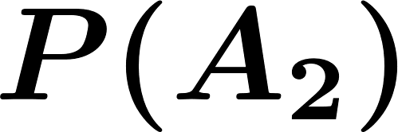
Probability
Event Probability of
We assign a probability to every event
The portion of times event is observed in a large number of runs of the experiment.
events
Chapter 1
Notes:
Now: Slides with Annotation
Next: Slides with Annotation

Slide 38




Probability
Axioms of Probability
Definition. A probability measure is a function that maps events in the sample space to real numbers. Such that:
For any event
Probability of the sample space is
For any countable collection of disjoint events
Chapter 1
Notes:
Now: Slides with Annotation
Next: Orchestrated Conversation

Slide 39
Orchestrated Conversation: Review and Discussion
Review of Video and Exercises from Lesson 1 Video 2
Chapter 1
Notes:
Now: Orchestrated Conversation
Next: Slides with Annotation

Slide 40
Probability
Roll a fair die (fair: outcomes are equally likely).
3rd axiom:
disjoint
Chapter 1
Notes:
Now: Slides with Annotation
Next: Slides with Annotation

Slide 41
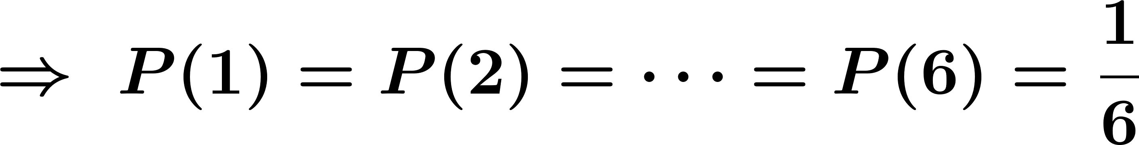
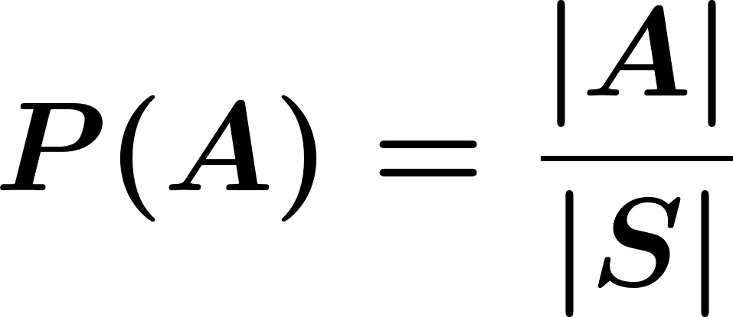
Probability
Equally likely outcomes:
disjoint
Chapter 1
Notes:
Now: Slides with Annotation
Next: Slides with Annotation

Slide 42



Probability
Using the axioms:
what is
disjoint
Chapter 1
Notes:
Now: Slides with Annotation
Next: Slides with Annotation

Slide 43





Probability
2)
empty
3)
Chapter 1
Notes:
Now: Slides with Annotation
Next: Slides with Annotation

Slide 44
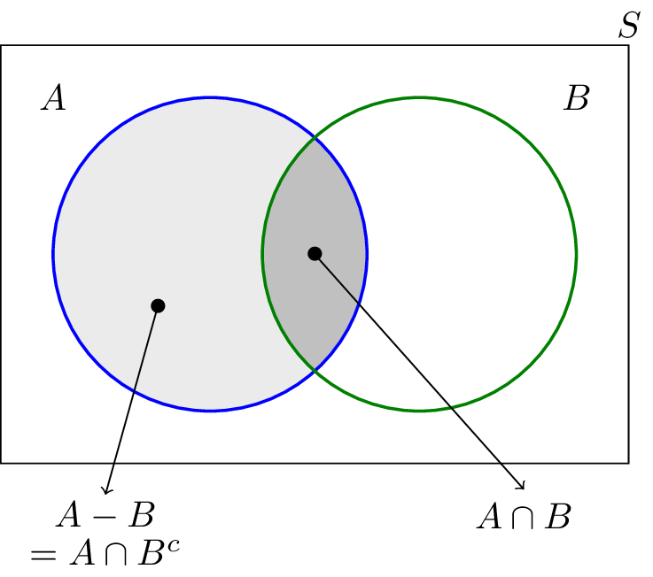
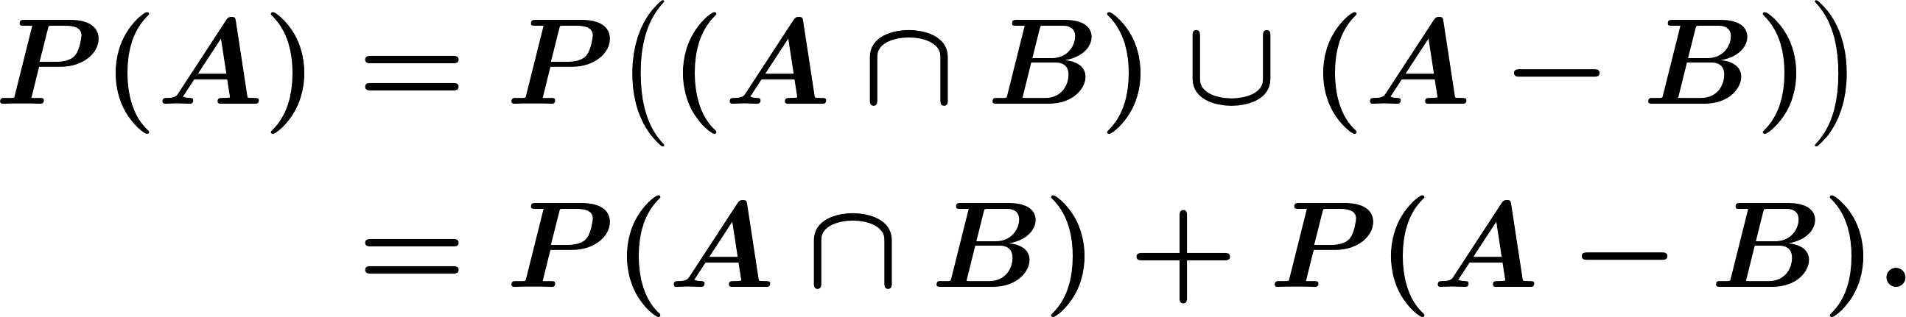
Probability
4)
Chapter 1
Notes:
Now: Slides with Annotation
Next: Slides with Annotation

Slide 45



Probability
5)
Use Venn diagram.
6)
Chapter 1
Notes:
Now: Slides with Annotation
Next: Slides with Annotation

Slide 46


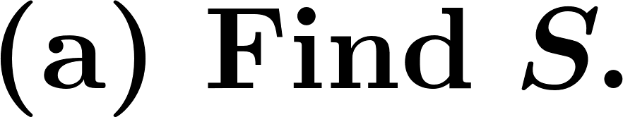
Probability
Example:
Roll a die twice and observed and
Chapter 1
Notes:
Now: Slides with Annotation
Next: Orchestrated Conversation

Slide 47
Orchestrated Conversation: Review and Discussion
Review of Video and Exercises from Lesson 1 Video 3
Chapter 1
Notes:
Now: Orchestrated Conversation
Next: Whiteboard

Slide 48
Whiteboard
Chapter 1
Notes:
Now: Whiteboard
Next: Slides with Annotation

Slide 49

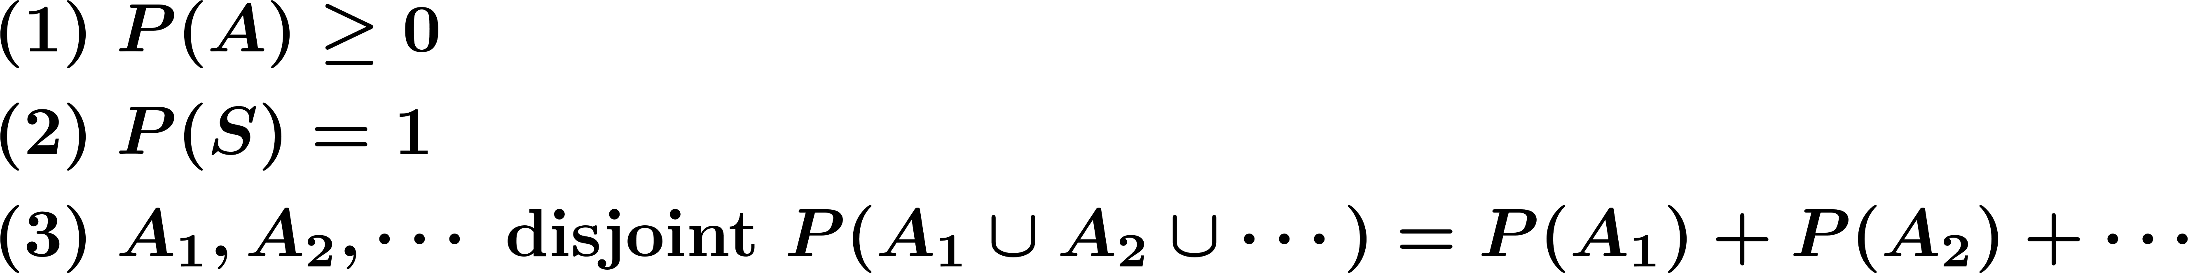
Summary
Probability:
Finite Sample Space with equally likely outcomes:
Chapter 1
Notes:
Now: Slides with Annotation
Next: Slides with Annotation

Slide 50


Sample Space
Sample Space:
Countable:
Discrete Probability Space
Chapter 1
Notes:
Now: Slides with Annotation
Next: Slides with Annotation

Slide 51
Sample Space
Uncountable
Continuous Probability Space
Chapter 1
Notes:
Now: Slides with Annotation
Next: Slides with Annotation

Slide 52



Continuous Probability Space
Example: I choose a point completely at random in
Chapter 1
Notes:
Now: Slides with Annotation
Next: Slides with Annotation

Slide 53





Continuous Probability Space
Key point: Axioms of Probability applies to continuous probability spaces.
Example: Suppose we know that the probability that a certain machine lasts more than or equal to years is :
Find the following sets:
Chapter 1
Notes:
Now: Slides with Annotation
Next: Slides with Annotation

Slide 54


Conditional Probability
Suppose that in a certain city, 0.3 percent of the days are rainy.
The probability that it rains given that it is cloudy might be:
Conditional probability: The probability given
Chapter 1
Notes:
Now: Slides with Annotation
Next: Slides with Annotation

Slide 55

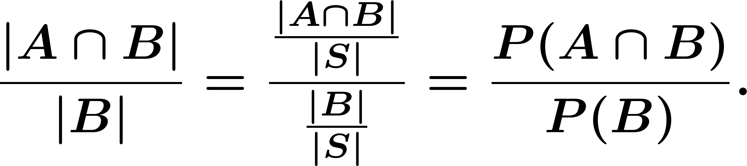
Conditional Probability
Example. Roll a fair die, what is the probability that the outcome is an even number given it was less than or equal to 3, i.e.,
Note:
Chapter 1
Notes:
Now: Slides with Annotation
Next: Slides with Annotation

Slide 56
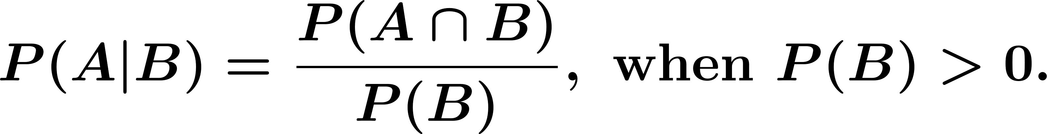
Conditional Probability
Definition: The Conditional Probability , the probability that occurred given that has occurred is given by
Chapter 1
Notes:
Now: Slides with Annotation
Next: Slides with Annotation

Slide 57
Summary of Probability
Axioms of Probability:
For any event
Probability of the sample space is
If are disjoint events, then
Chapter 1
Notes:
Now: Slides with Annotation
Next: Slides with Annotation

Slide 58

Conditional Probability
If and are two events in a sample space then
Chapter 1
Notes:
Now: Slides with Annotation
Next: Slides with Annotation

Slide 59


Conditional Probability
Conditional probability satisfies the probability axioms :
For any event
Conditional probability of given is
Chapter 1
Notes:
Now: Slides with Annotation
Next: Slides with Annotation

Slide 60
Conditional Probability
If are disjoint events, then
Chapter 1
Notes:
Now: Slides with Annotation
Next: Slides with Annotation

Slide 61


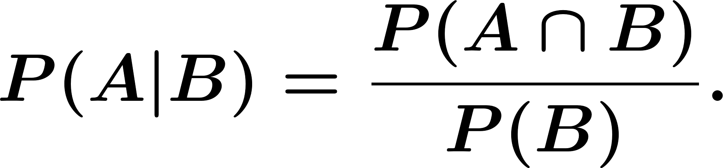
Conditional Probability
Example. Roll two dice
: 3 dots are shown at least on one die
Find
Chapter 1
Notes:
Now: Slides with Annotation
Next: Slides with Annotation

Slide 62


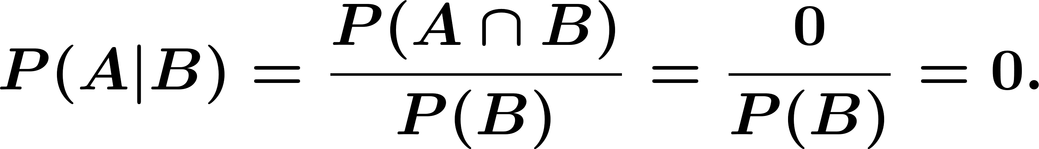

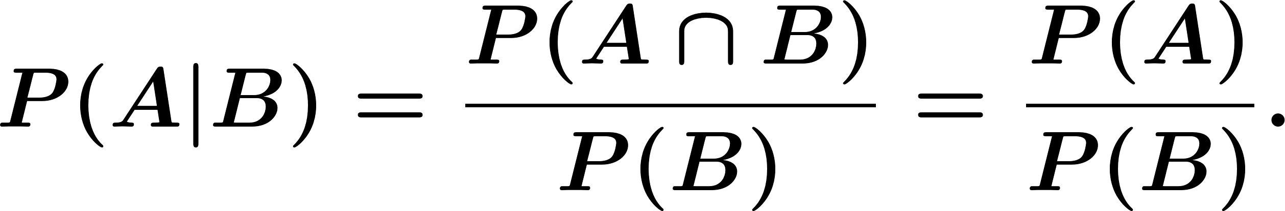
Conditional Probability
Special cases:
and are disjoint:
Chapter 1
Notes:
Now: Slides with Annotation
Next: Slides with Annotation

Slide 63

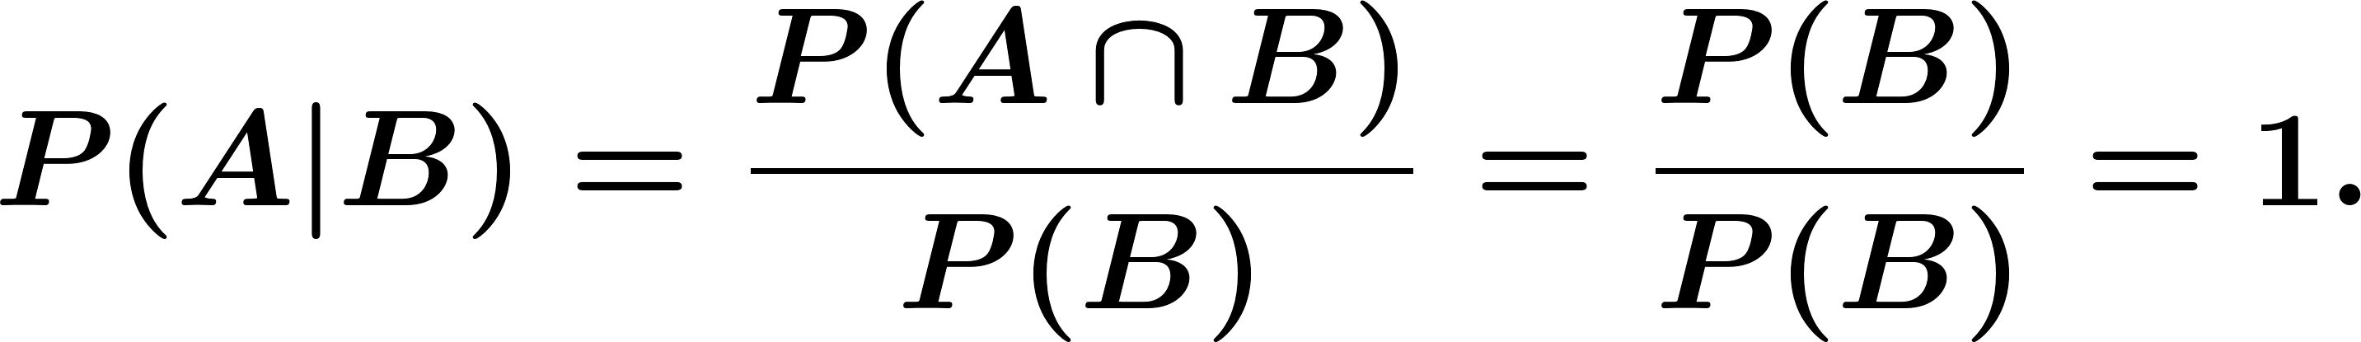
Conditional Probability
Chapter 1
Notes:
Now: Slides with Annotation
Next: Slides with Annotation

Slide 64



Conditional Probability
Example. Roll a die, what is the probability that it is larger than or equal to 5, given that it is an even number ?
, even number
Chapter 1
Notes:
Now: Slides with Annotation
Next: Slides with Annotation

Slide 65

Conditional Probability
Definition: Two events and are independent if and only if
equivalently
Chapter 1
Notes:
Now: Slides with Annotation
Next: Slides with Annotation

Slide 66

Conditional Probability
Warning!
Disjoint (mutually exclusive) Independent
Disjoint:
Independent:
Chapter 1
Notes:
Now: Slides with Annotation
Next: Slides with Annotation

Slide 67

Conditional Probability
Suppose and are disjoint:
If
If disjoint Not independent.
Chapter 1
Notes:
Now: Slides with Annotation
Next: Slides with Annotation

Slide 68



Conditional Probability
Example:
Event that there is a connection from node to node
independent
Chapter 1
Notes:
Now: Slides with Annotation
Next: Slides with Annotation

Slide 69




Conditional Probability
Remark:
If are independent, then
are independent.
are independent.
are independent.
Chapter 1
Notes:
Now: Slides with Annotation
Next: Slides with Annotation

Slide 70


Conditional Probability
Example:
Find
Note that are independent.
independent
Chapter 1
Notes:
Now: Slides with Annotation
Next: Slides with Annotation

Slide 71
Conditional Probability
If and are two events in a sample space then the conditional probability of given is defined as
Chapter 1
Notes:
Now: Slides with Annotation
Next: Slides with Annotation

Slide 72
Independence
Two events and are independent if and only if
Chapter 1
Notes:
Now: Slides with Annotation
Next: Slides with Annotation

Slide 73


Independence
Three events and are independent if all of the following conditions hold
Chapter 1
Notes:
Now: Slides with Annotation
Next: Slides with Annotation

Slide 74


Independence
Example.
Two darts players throw alternately at a board and the first to score a bull wins. On each of their throws player has probability and player of success; the result of different throws are independent. If starts, calculate the probability that he/she wins.
Chapter 1
Notes:
Now: Slides with Annotation
Next: Slides with Annotation

Slide 75


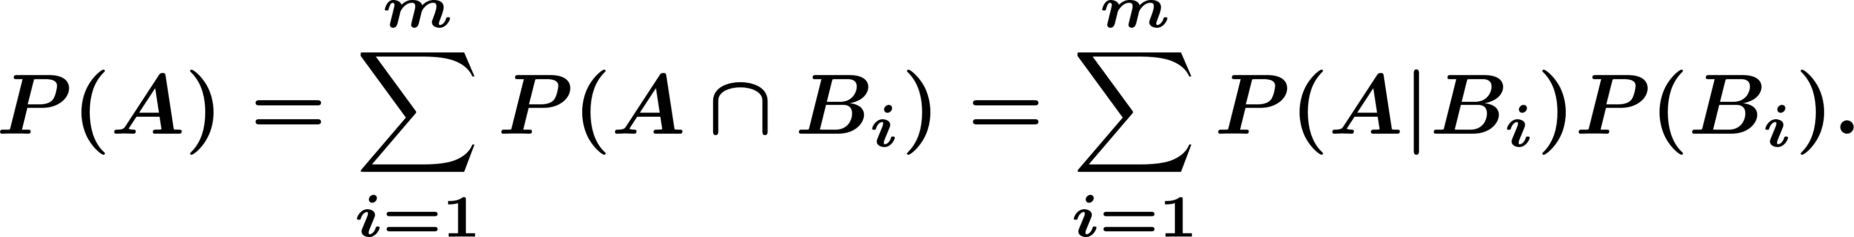
Law of Total Probability
Let be a partition of the sample space with
For any event we have
Chapter 1
Notes:
Now: Slides with Annotation
Next: Slides with Annotation

Slide 76

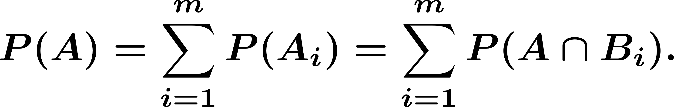
Law of Total Probability
Chapter 1
Notes:
Now: Slides with Annotation
Next: Orchestrated Conversation

Slide 77



Orchestrated Conversation: Law of Total Probability
Example:
Three coins are in a bag:
Coin 1: probability of heads is 0.9.
Coin 2: probability of heads is 0.6.
Coin 3: probability of heads is 0.3.
I draw a coin at random and toss it. What is the probability of heads?
Chapter 1
Notes:
Now: Orchestrated Conversation
Next: Slides with Annotation

Slide 78
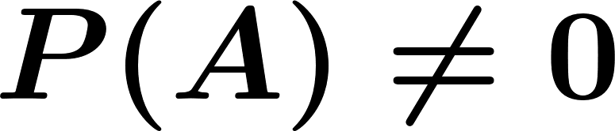
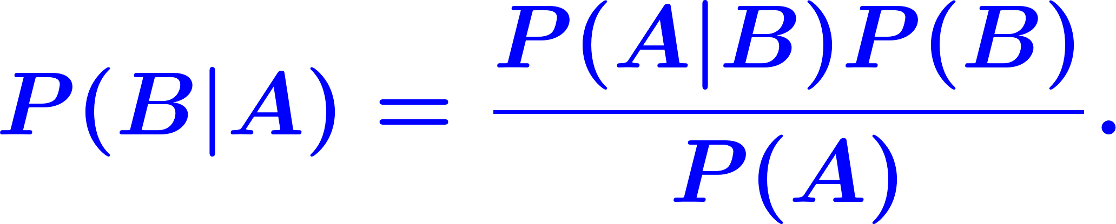
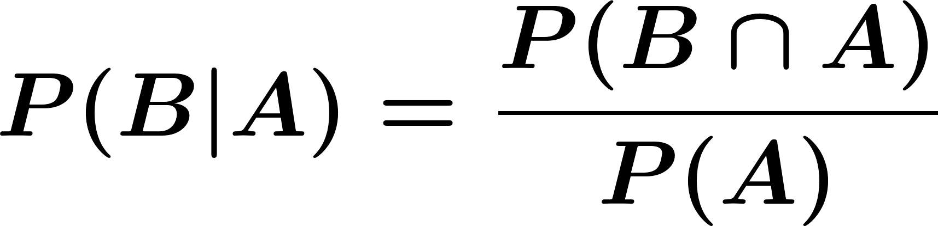
Bayes' Rule
For any two events and , where , we have
Chapter 1
Notes:
Now: Slides with Annotation
Next: Slides with Annotation

Slide 79

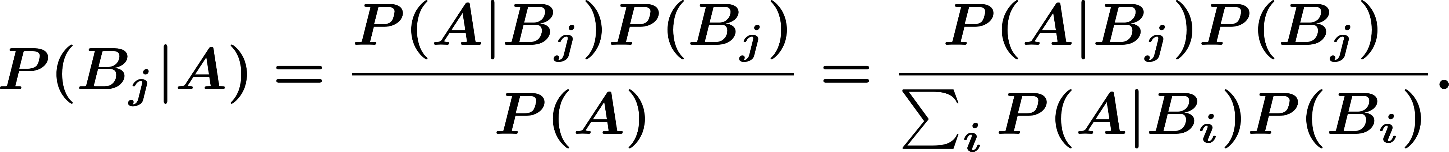
Bayes' Rule
If is a partition of the sample space , and is any event with we have
Chapter 1
Notes:
Now: Slides with Annotation
Next: Orchestrated Conversation

Slide 80
Orchestrated Conversation: Bayes' Rule
Example.
In the previous problem, suppose that we know the result is heads; what is the probability that Coin 1 was chosen?
Chapter 1
Notes:
Now: Orchestrated Conversation
Next: Slides with Annotation

Slide 81


Bayes' Rule
Example. In a communication system a zero or a one is transmitted with the probability or respectively. Due to the noise in the channel, a zero can be received as a one, with probability and a one can be received as a zero also with probability . A one was observed, what is the probability that a one was transmitted?
Chapter 1
Notes:
Now: Slides with Annotation
Next: Slides with Annotation

Slide 82

Conditional Independence
Two events and are independent if and only if
Two events and are conditionally independent given an event if and only if
Chapter 1
Notes:
Now: Slides with Annotation
Next: Slides with Annotation

Slide 83
Chain Rule for Conditional Probability
We can extend this to 3 or more events:
Chapter 1
Notes:
Now: Slides with Annotation
Next: Slides with Annotation

Slide 84
Summary of this Lesson
You explored the basic concepts of probability that will provide a foundation for discussion of probability throughout this term. You also reviewed mathematical concepts needed to understand probability theory. You had the opportunity to examine random experiments and the axioms of probability. Additionally, you explored discrete and continuous probability models and discussed conditional probability.
Chapter 1
Notes:
Now: Slides with Annotation
Next: Slides with Annotation

Slide 85
Post-work for Lessons 1-3
Complete homework assignment for Lessons 1-3: HW#1
Go to the online classroom for details.
Chapter 1
Notes:
Now: Slides with Annotation
Next: Slides with Annotation

Slide 86
To Prepare for the Next Lesson
Read Chapter 2 in your online textbook:
https://www.probabilitycourse.com/chapter2/2_1_0_counting.php
Complete the Pre-work for Lesson 4.
Visit the online classroom for details.
Chapter 1
Notes:
Now: Slides with Annotation

